Slide 1
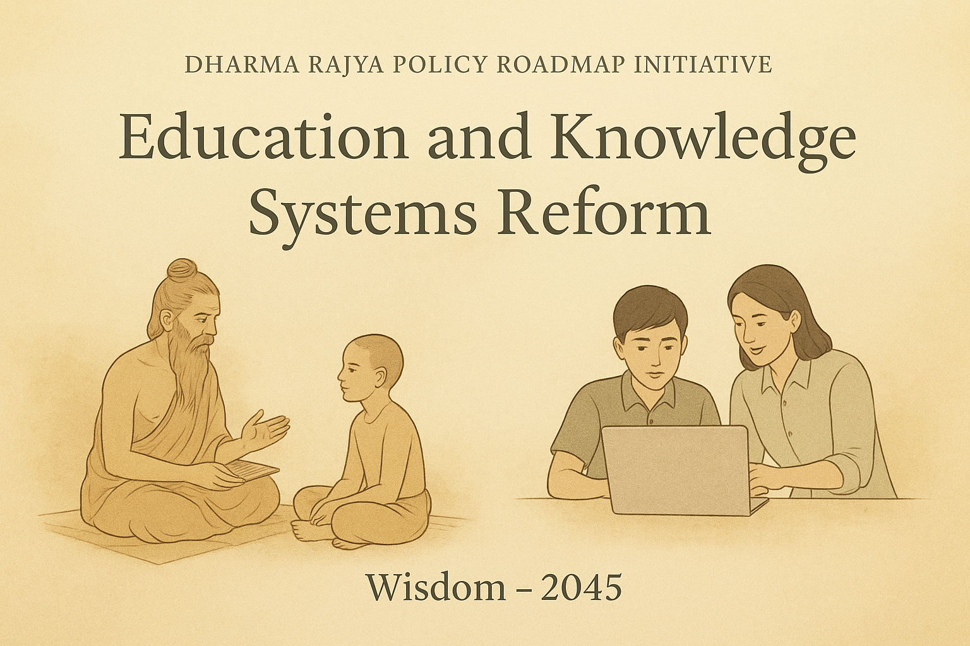

Slide 2

Defining Role of Education
Vision of Dharma Rajya
  India’s education to promote harmony, creativity, and inclusive leadership as part of Dharma Rajya.
  Connection with Nature
  Education helps individuals see themselves as integral to nature, fostering mutual dependence and spiritual growth.
Holistic Development
  Educational institutions must promote early holistic growth and nurture authentic leadership qualities in students.
Action-Oriented Leadership
  Leadership demonstrated through actions, ensuring resilience and grounded in change.
Challenges of Technology
  Technology is an enabler but rapid advances risk diminishing human connection and cultural values in society.
Notes:
---
This slide references information from the following file: https://d.docs.live.net/3E4C3BFDB059BD48/Microsoft%20Copilot%20Chat%20Files/Dharma%20Rajya%20Education%2010082025.docx
Education plays a pivotal role in helping individuals recognize themselves as integral parts of nature. It encourages mutual dependence and personal growth through spiritual awareness. As technology accelerates, human connection and cultural values risk being diminished. Educational institutions must restore relevance by promoting early holistic development and cultivating authentic leadership qualities. These qualities should be demonstrated through action rather than rhetoric, ensuring students remain resilient and grounded in a rapidly changing world.

Slide 3

Transformative Educational Framework
  NEP 2020 introduced a transformative framework to reshape India's education system with innovative reforms.
Focus on Foundational Reform
  Dharma Rajya targets foundational reforms for grades 3–12 to nurture inventive and confident future leaders.
Vision for 2035 Leadership
  Establish India as a global leader through holistic education aligned with Dharma Rajya principles.
Notes:
---
This slide references information from the following file: https://d.docs.live.net/3E4C3BFDB059BD48/Microsoft%20Copilot%20Chat%20Files/Dharma%20Rajya%20Education%2010082025.docx
The National Education Policy (NEP) 2020 offers a transformative framework aimed at reshaping India's educational landscape. Its success hinges on timely and coordinated action across various stakeholders. The strategy focuses on foundational reform for grades 3–12, aiming to nurture inventive and confident leaders capable of fostering harmonious and prosperous communities. By 2035, the goal is to establish India as a holistic global leader through education that aligns with the principles of Dharma Rajya.

Slide 4
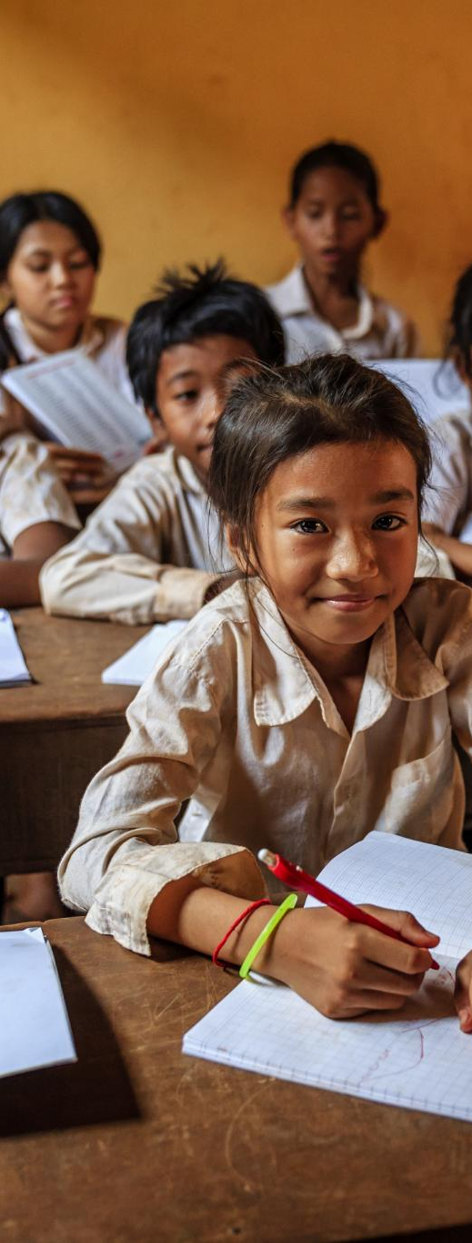
Challenges
Legacy of Rote Learning
  Colonial-era rote learning limits critical and creative thinking needed for today's economy.
Infrastructure Deficiencies
  About 30% of rural schools lack basic amenities like electricity and clean water.
Regional Disparities
  Unequal curricula and resources across regions hinder cohesive national educational development.
Poor Learning Outcomes
  Fewer than half of Grade 5 students can read Grade 2-level texts despite rising literacy rates.
Notes:
---
This slide references information from the following file: https://d.docs.live.net/3E4C3BFDB059BD48/Microsoft%20Copilot%20Chat%20Files/Dharma%20Rajya%20Education%2010082025.docx
India’s education system faces several systemic challenges. The legacy of colonial-era rote learning suppresses critical and creative thinking, which is essential for the 21st-century economy. Infrastructure gaps persist, with approximately 30% of rural schools lacking basic amenities like electricity and clean water. Regional disparities in curricula and resources hinder cohesive national development. Despite a rise in literacy rates, learning outcomes remain poor, with fewer than half of Grade 5 students able to read Grade 2-level texts.

Slide 5
Cost-Effective Model
Component | Description
Structured Assessments | Periodic evaluations based on Bloom’s taxonomy
Targeted Remediation | Individual literacy gap interventions
Experiential Learning | Project-based and digital engagement
Adaptive Learning | Personalized challenges for gradual progression
Continuous Improvement | Real-time data to refine teaching methods
Notes:
---
This slide references information from the following file: https://d.docs.live.net/3E4C3BFDB059BD48/Microsoft%20Copilot%20Chat%20Files/Dharma%20Rajya%20Education%2010082025.docx
The proposed cost-effective model for educational transformation involves an additional investment of ₹400 per student annually—just 0.6% more than current spending. This modest increase can yield significant benefits through a five-pronged approach: structured, competency-based assessments; targeted remediation to address foundational literacy gaps; experiential learning via project-based activities and digital tools; adaptive learning tailored to individual student needs; and continuous improvement using real-time performance data. This strategy aims to enhance cognitive skills, employability, and global competitiveness.

Slide 6
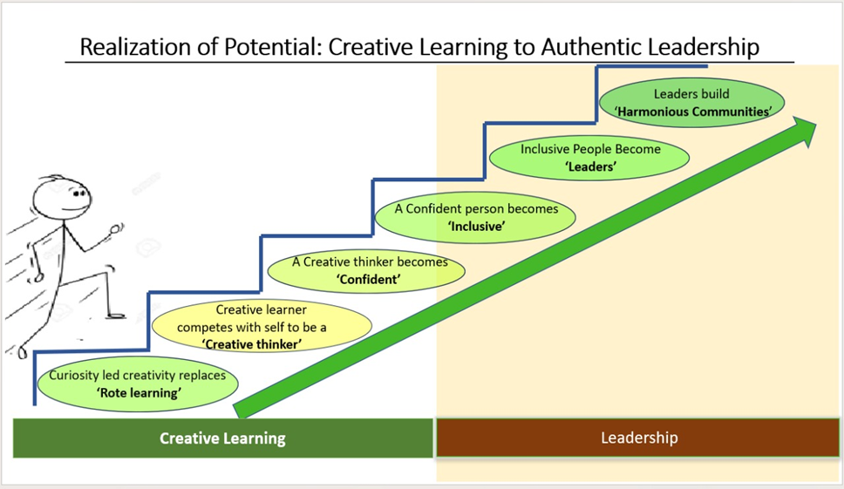
Creative Learning & Leadership

Slide 7
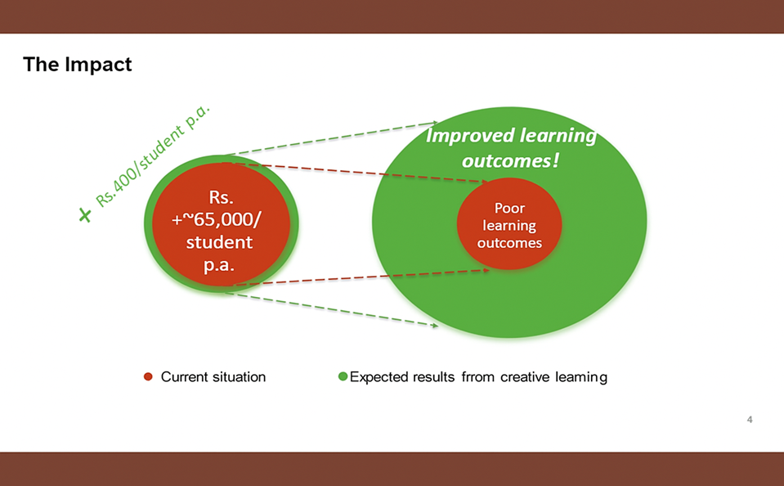
So much for so little: invest in learning outcomes

Slide 8

Immediate Actions
Universal Creative Learning
  Implement creative learning for primary and secondary students to foster innovation and engagement.
Teacher Upskilling Expansion
  Expand NISHTHA program to train 2.5 million educators by 2027, enhancing teaching quality.
Community and Technology Integration
  Engage communities by using schools as resource hubs and scale digital platforms with pilot programs.
Leadership Development
  Target 5–10% of students for leadership training to create positive ripple effects in communities.
Notes:
---
This slide references information from the following file: https://d.docs.live.net/3E4C3BFDB059BD48/Microsoft%20Copilot%20Chat%20Files/Dharma%20Rajya%20Education%2010082025.docx
To initiate transformation, several immediate actions are proposed: universal creative learning for all primary and secondary students; leadership development targeting 5–10% of students to create ripple effects; teacher upskilling through expansion of NISHTHA to train 2.5 million educators by 2027; community involvement by positioning schools as resource-sharing hubs; scaling technology platforms like DIKSHA, SWAYAM, and NDLI; and launching pilot programs in 100 districts by 2026 using digital monitoring tools. These steps aim to ensure equitable and sustainable adoption.

Slide 9

Higher Education Reforms
Unified Regulation
  The Higher Education Commission of India (HECI) aims to create a unified regulatory framework for all higher education institutions.
Flexible Multidisciplinary Degrees
  New degrees offer multiple entry and exit points, promoting flexibility and interdisciplinary learning.
Internationalization and Expansion
  Efforts to attract foreign universities and expand IITs globally aim to enhance India’s higher education reach and quality.
Vocational Training and Regional Access
  Half of all curricula will integrate vocational training, and quality institutions will be available in every district.
Notes:
---
This slide references information from the following file: https://d.docs.live.net/3E4C3BFDB059BD48/Microsoft%20Copilot%20Chat%20Files/Dharma%20Rajya%20Education%2010082025.docx
NEP 2020 sets ambitious goals for higher education, aiming to increase the Gross Enrollment Ratio (GER) from 28.4% to 50% by 2035. Key reforms include launching the Higher Education Commission of India (HECI) for unified regulation; introducing flexible, multidisciplinary degrees with multiple entry/exit points; promoting internationalization by attracting foreign universities and expanding IITs globally; ensuring regional access with quality institutions in every district; integrating vocational training into half of all curricula; and strengthening research through the National Research Foundation.

Slide 10
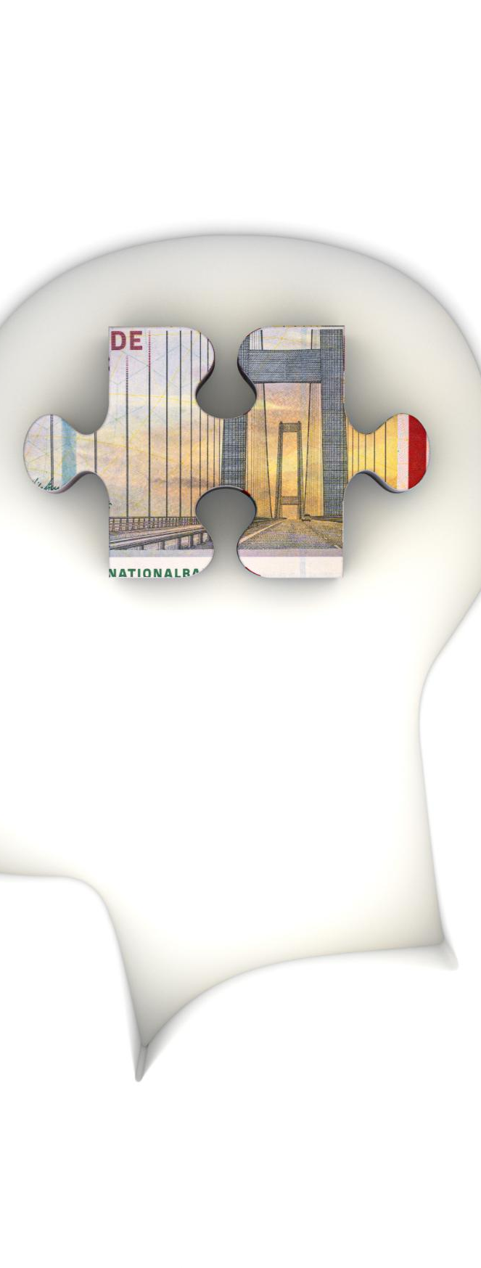
Conclusion & call to action
Transformative Education
  Education to foster creativity, confidence, and inclusivity in India’s future generations.
Cultural Heritage and Unity
  Harmonious and purpose-driven society built by honoring cultural heritage and bridging divides.
Unified Stakeholder Collaboration
  Collaboration among government, educators, communities, and technologists to drive the vision forward
Affordable Investment and Reform
  Affordable investments & systemic higher education reforms for enabling effective educational transformation
Robust Oversight Mechanisms
  Establishing strong monitoring and accountability systems will ensure steady progress toward goals.
Notes:
---
This slide references information from the following file: https://d.docs.live.net/3E4C3BFDB059BD48/Microsoft%20Copilot%20Chat%20Files/Dharma%20Rajya%20Education%2010082025.docx
Transformative education is the cornerstone of Dharma Rajya. By implementing a focused six-step process, making affordable investments, and enacting systemic higher education reforms, India can cultivate a generation rooted in creativity, confidence, and inclusivity. This approach will bridge societal divides, honor cultural heritage, and position India as a global knowledge leader by 2035. The journey requires commitment to collaboration, innovative financing, and robust oversight to build a harmonious, purpose-driven society.

