Slide 1

Dharma Rajya: A Holistic Healthcare Model for India
A sustainable approach to universal healthcare coverage that honors India's cultural heritage while ensuring global competitiveness and environmental harmony

Slide 2
Current Healthcare Landscape in India
Challenges
Opportunity
High-cost curative model unaffordable for most citizens
As India moves from the 4th to 3rd largest economy in the next 3 years, Dharma Rajya offers a distinctive economic moat through holistic healthcare that:
Central Government healthcare budget allocation increased to ₹1 lakh crores in 2025-26
Out-of-pocket expenditure still at 39% of total health expenditure. Possibly higher if unreported spending and unaccounted corruption for providing services are added.
Delivers higher happiness per unit of GDP
Costs less than conventional approaches
Positions India as "Viswa Bandhu"

Slide 3




The Preventive Healthcare Pyramid
Specialty Hospitals
1
Advanced care for complex conditions
Regional Hospitals
2
Comprehensive treatment facilities
Primary Healthcare Centers (35,000+)
3
AI-supported diagnosis and treatment
Community Wellness Centers (280,000)
4
Preventive care through yoga, pranayama, meditation
A ground-up approach prioritizing prevention over expensive treatment, with each level supporting the one above it

Slide 4
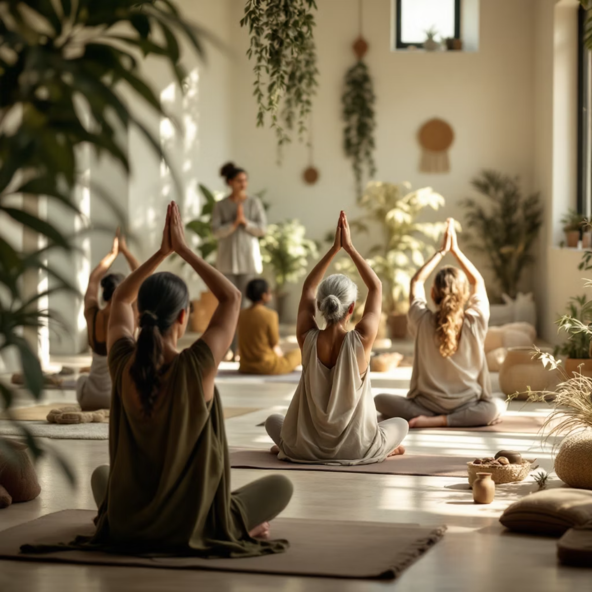
Community Wellness Centers: The Foundation
Key Features
One center per 5,000 citizens
Located in existing infrastructure where possible (schools, Panchayats)
Daily yoga, pranayama, and meditation programs
Nutrition guidance with organic food availability for purchase
Community-based lifestyle modification support

Slide 5










Integrative Treatment Approach
Ayurveda
Allopathy
For chronic conditions, constitutional improvement, and preventive care
For acute conditions, infectious diseases, and childhood immunizations
Homeopathy
For chronic conditions with minimal side effects
Naturopathy
Natural healing through lifestyle, diet, and natural therapies
Siddha
Traditional Tamil system focusing on balance of elements

Slide 6

Implementation Costs: Community Wellness Centers
Initial setup average cost per center
₹1,870,000
Annual maintenance per center
₹1,000,000
Total centers (1 per 5,000 people)
175,000 in operation now
280,000
Additional capital expenditure
₹23,400 crore+
Annual operational expenditure
₹28,000 crore+
Based on population of 1.4 billion and cost estimates from similar government wellness initiatives including the comprehensive Gujarat implementation . Infrastructure and maintenance costs adjusted to approximate market rates per center on average.

Slide 7
Benefits and Cost Savings
25-30%
₹2L Cr+
7 Yrs
15%+
Reduction in Chronic Disease
Annual Savings
Return Period
Productivity Gain
Estimated annual reduction in healthcare costs after full implementation, based on decreased hospitalization and medication needs
Time frame for investment in wellness centers to be offset by healthcare savings
Projected increase in workforce productivity through improved health outcomes and reduced sick days
Projected decrease in diabetes, hypertension, and heart disease over 10 years through preventive care

Slide 8
Tiered Healthcare Access Framework
1
2
Universal Preventive Care
Lifestyle-Based Entitlements
Free access to all Community Wellness Centers and preventive programs regardless of income with built in incentives for participation
Additional benefits for citizens who participate in preventive programs and maintain healthy lifestyle metrics
3
4
Income-Based Treatment Coverage
Competitive Public-Private Integration
Tiered payment structure for advanced treatments based on income level, with full coverage for those below poverty line adjusted to prior wellness program participation credits and healthy lifestyle metrics
Government institutions competing with private providers including nonprofits to maintain quality while controlling costs

Slide 9

Path Forward: Dharma Rajya Healthcare Vision
Next Steps
Pilot 1,000 Community Wellness Centers in diverse settings
Develop AI-supported diagnostic systems for Primary Healthcare Centers
Create certification programs for yoga and Ayurvedic practitioners
Establish organic food supply chains linked to wellness centers
Implement lifestyle-based incentive systems with measurable metrics
Dharma Rajya's holistic healthcare approach positions India as a global leader in sustainable, culturally-rooted wellness while ensuring universal coverage

